Slide 1

HTML Standards
History of HTML
The <doctype> Element
W3C Validator
The <meta> Element

Slide 2

See Also
https://en.wikipedia.org/wiki/HTML
https://www.w3.org/People/Raggett/book4/ch02.html

Slide 3

In the Book
Chapter 6:
Standards and All that Jazz

Slide 4

(Brief) History of HTML
1989: Tim Berners-Lee wrote a memo proposing an internet-based hypertext system.
Father of HTML and the WWW
11 of his original 18 tags are still used in HTML today.
https://upload.wikimedia.org/wikipedia/commons/c/c8/Tim_Berners-Lee_April_2009.jpg

Slide 5

HTML3
1995: The Browser Wars
Netscape and Microsoft
Added custom features to attract users
Developers wrote separate pages for IE and Netscape

Slide 6


HTML4
1998: W3C Consortium
Created ONE standard for everyone
Separate CSS (presentation) and HTML (structure)

Slide 7

XHTML
2001: XML is the new Shiny Object
HTML is “almost” XML
Move to make HTML more rigid … an XML dialect
Easier for the browsers to parse
Developers were used to the looseness of HTML (e.g. no closing <img> tag)

Slide 8

HTML5
2009: The LAST HTML Version Ever
HTML is a living standard
New features will be added but no new version number
Always backwards compatible
Lots of new features:
Video and Graphics
Support for blog-like elements
Structure elements to support a variety of devices

Slide 9
DOCTYPE
<!DOCTYPE html PUBLIC
"-//W3C//DTD HTML 4.01//EN"
"http://www.w3.org/TR/html4/strict.dtd">
<!DOCTYPE html PUBLIC
"-//W3C//DTD XHTML 1.1//EN"
"http://www.w3.org/TR/xhtml11/DTD/xhtml11.dtd">

Slide 10
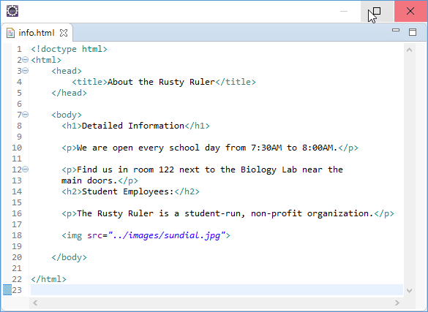
HTML5 DOCTYPE
<!doctype html>

Slide 11
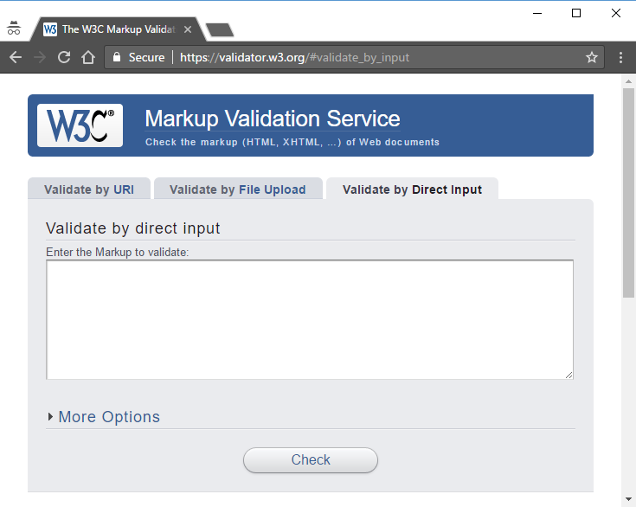
W3C Validator
https://validator.w3.org/

Slide 12
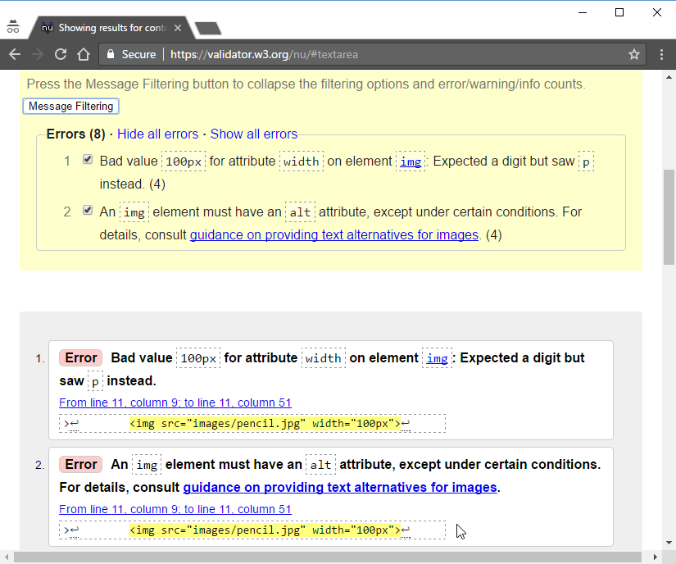

Slide 13
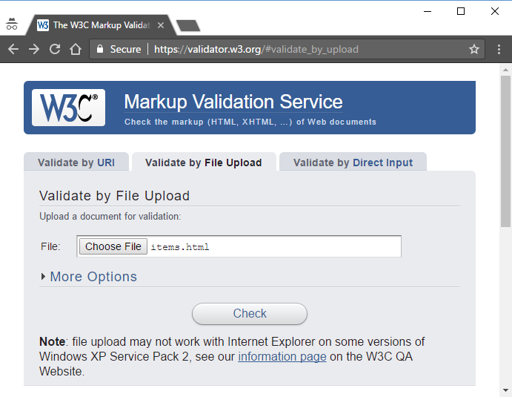
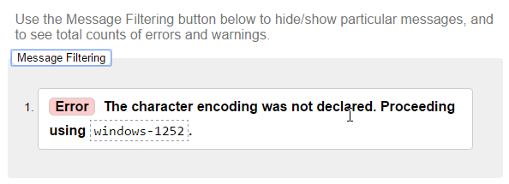
Uploaded File

Slide 14
Meta Tag
<!doctype html>
<html>
<head>
<title>The Rusty Ruler Supplies</title>
<meta charset="utf-8">
</head>
<body>
</body>
</html>
windows-1252
utf-8
iso-8859-1

Slide 15

Remember
Always begin with a <doctype>
Everything else goes inside <html> … </html>
Use <head> and <body>
Include <meta> in the <head>

Slide 16

Tinkering
Pick a previous project from this class and run the HTML files through the W3C validator.
Add the correct <doctype> and <meta> tags.

